Slide 1
1. Download Tisean
https://www.pks.mpg.de/tisean/TISEAN_3.0.0-windows.zip
And decompress it

Slide 2
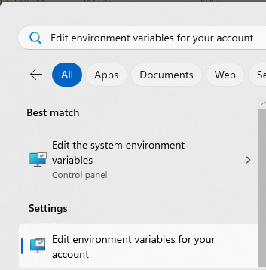
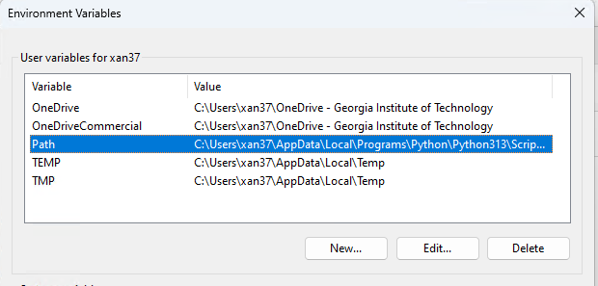
2. Add Tisean to PATH
Search PATH:
If personal PC, choose first one
If school PC, choose second one
Double click path

Slide 3
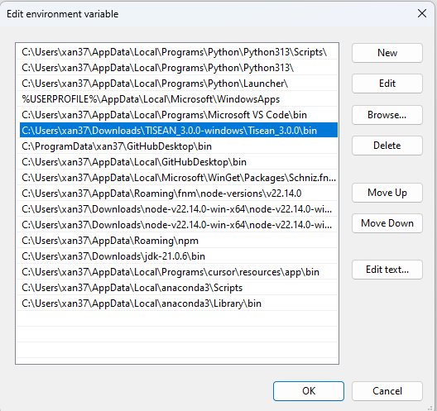
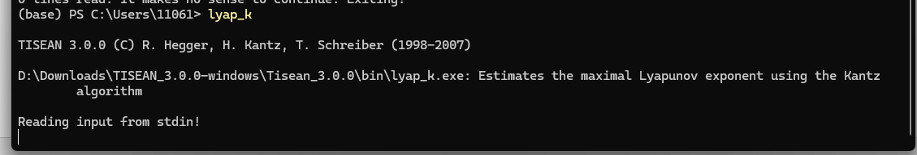
Add Tisean bin folder into it
Now you can call Tisean function in Windows terminal

Slide 4
3. Automate it in Python
from pathlib import Path
with open("output.dat", "w") as f:
for val in voltage:
f.write(f"{val}\n")
proc = subprocess.Popen(
["lyap_k", "output.dat", "-M3","-m3"],
stdout=subprocess.PIPE,
stderr=subprocess.STDOUT,
text=True
)
for line in proc.stdout:
print(line, end="") # prints each line as lyap_k produces it

